Slide 1
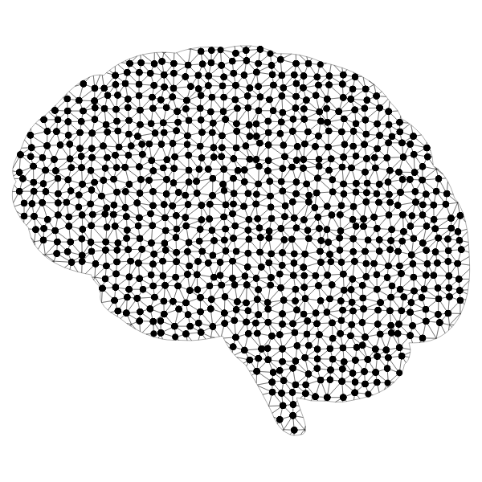

AI Section 6: Ethics in AI - Part I: Responsibility in AI

Slide 2
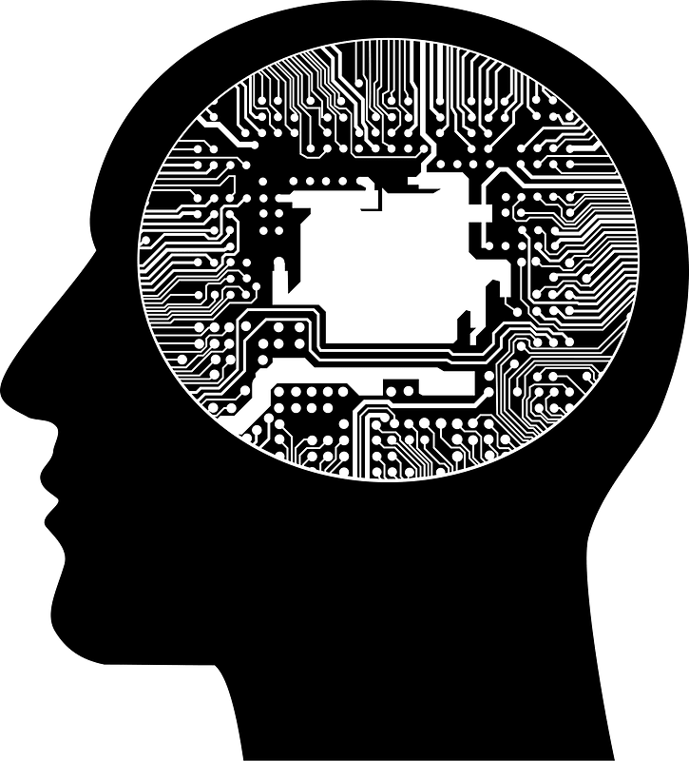
What Damage Can Irresponsible AI Cause?
Discuss and answer the following questions with those around you:
Given the databases certain AI use to make predictions, what kind of issues could arise if operations are handled carelessly?
Is the safe use of AI the responsibility of the creator/company OR the user? Is it both?

Slide 3
What are the Ethical Concerns of AI?
How can AI be a threat to humanity’s overall well-being?
Who possesses liability when AI malfunctions or there are unintended outcomes?
When an application of AI, such as a self-driving car, is the cause of an accident, who is at fault, who is liable?
The possibility of AI replacing human workers in many jobs and careers.
Will AI result in a large shift of one high in-demand to another, or an overall reduction of jobs, such as the elimination of many customer service positions?
What other jobs might be replaced by further advancements made in AI?

Slide 4
What are the Ethical Concerns of AI?
Will AI compromise the privacy of users of these applications?
Is consent from users to store their data enough? Are users informed enough about the data being stored? How do we ensure data is completely secure or not misused after collection?
How can AI be trained/created to avoid the introduction of bias and discrimination?
If AI is used during the hiring process for jobs, or the selection process for college enrollment, bias and discrimination can have very detrimental consequences.
Should some decisions not be left for AI to make? Should certain information about the user be disregarded when making a decision?

Slide 5
What are the Ethical Concerns of AI?
Lastly, who will be held accountable for maintaining ethical AI practices and ensuring safeguards are in place to prevent the misuse of AI?
Will there be laws set in place to regulate the use and creation of Artificial Intelligence?
Some countries have already started working towards creating legislation to ensure privacy and security of users and their data. Others have temporarily banned applications such as ChatGPT to ensure important data is not breached.

Slide 6

How Would You Address These Ethical Concerns?
Discuss each ethical concern and brainstorm possible solutions with those around you:
You can fill out the table below in your OneNote Notebook
Ethical Concern: | Solution:
Liability for AI Malfunctions
Replacing Human Workers
Breaching User Data/Privacy
Bias and Discrimination Effecting Output
Accountability for Ethical Use/Creation

Slide 7
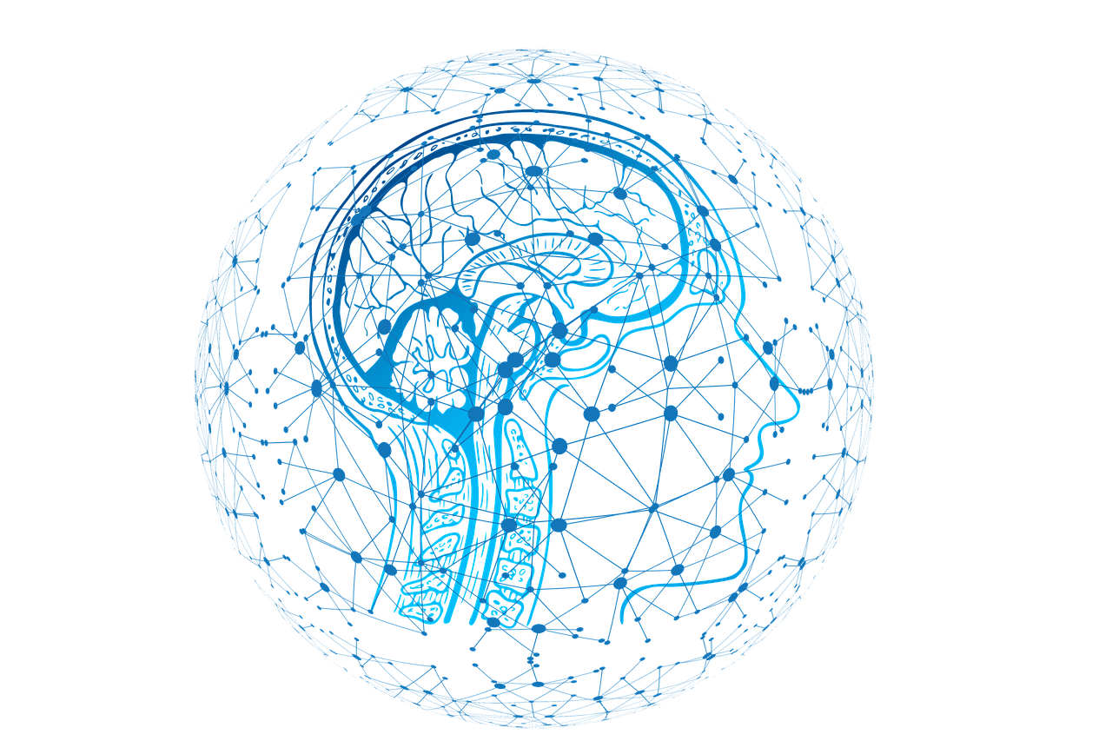
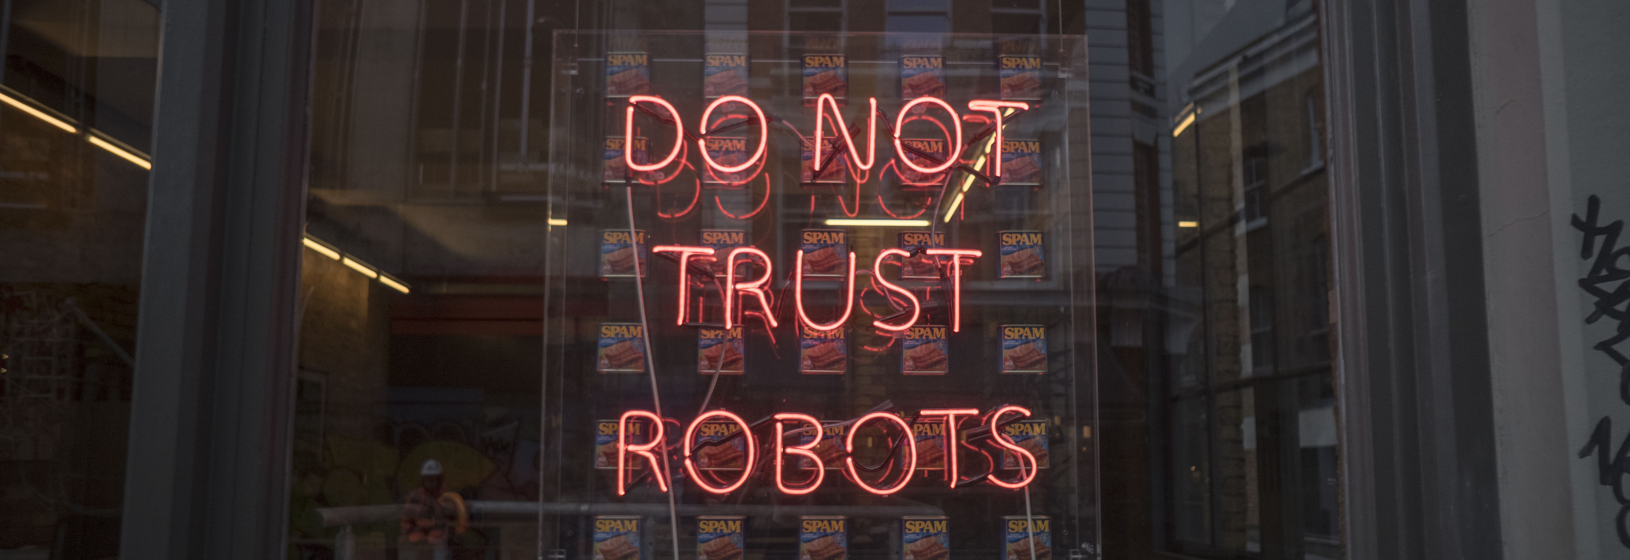
How do we Adopt AI Responsibly?
IBM suggests the “5 Pillars of Trust in Artificial Intelligence” when adopting AI
Trust In Artificial Intelligence
Explainability
Privacy
Fairness
Transparency
Robustness

Slide 8

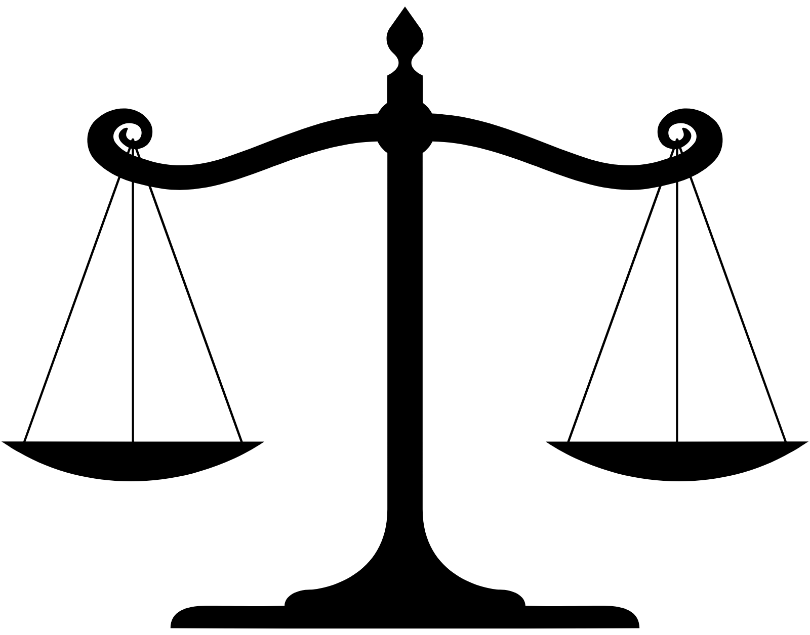
How do we Adopt AI Responsibly?
Explainability:
AI should have a clearly defined method and algorithm that is detailed to the user. In addition to ethical “data lineage”.
Data Lineage is the pipeline in which data travels, it is knowledge about the data’s source, how it was manipulated and processed, as well as its end destination and use.
Fairness:
Ensuring that AI has no biases against underrepresented groups and individuals within a system are treated equally. AI must be designed in a manner to counterbalance human biases in decision making.

Slide 9


How do we Adopt AI Responsibly?
Robustness:
The risk of data breaches should be minimized, and information should be secure. It should be of utmost importance that results are not tampered with and biases are not able to be introduced into the algorithm.
Transparency:
Tools used by creators for governing AI and their training/creation should be observable by users to understand the limitations and capabilities of the application as well as its life cycle.

Slide 10


How do we Adopt AI Responsibly?
Privacy:
The AI system should upkeep data rights/regulations and maintain the privacy of users by keeping personally identifiable data secure.
The use of personal data should be explicitly stated and information about its security should be given to the user.
How close were your proposed solutions to the warnings/guidelines IBM proposes when adopting Artificial Intelligence? Do you think anything else should be considered?

Slide 11

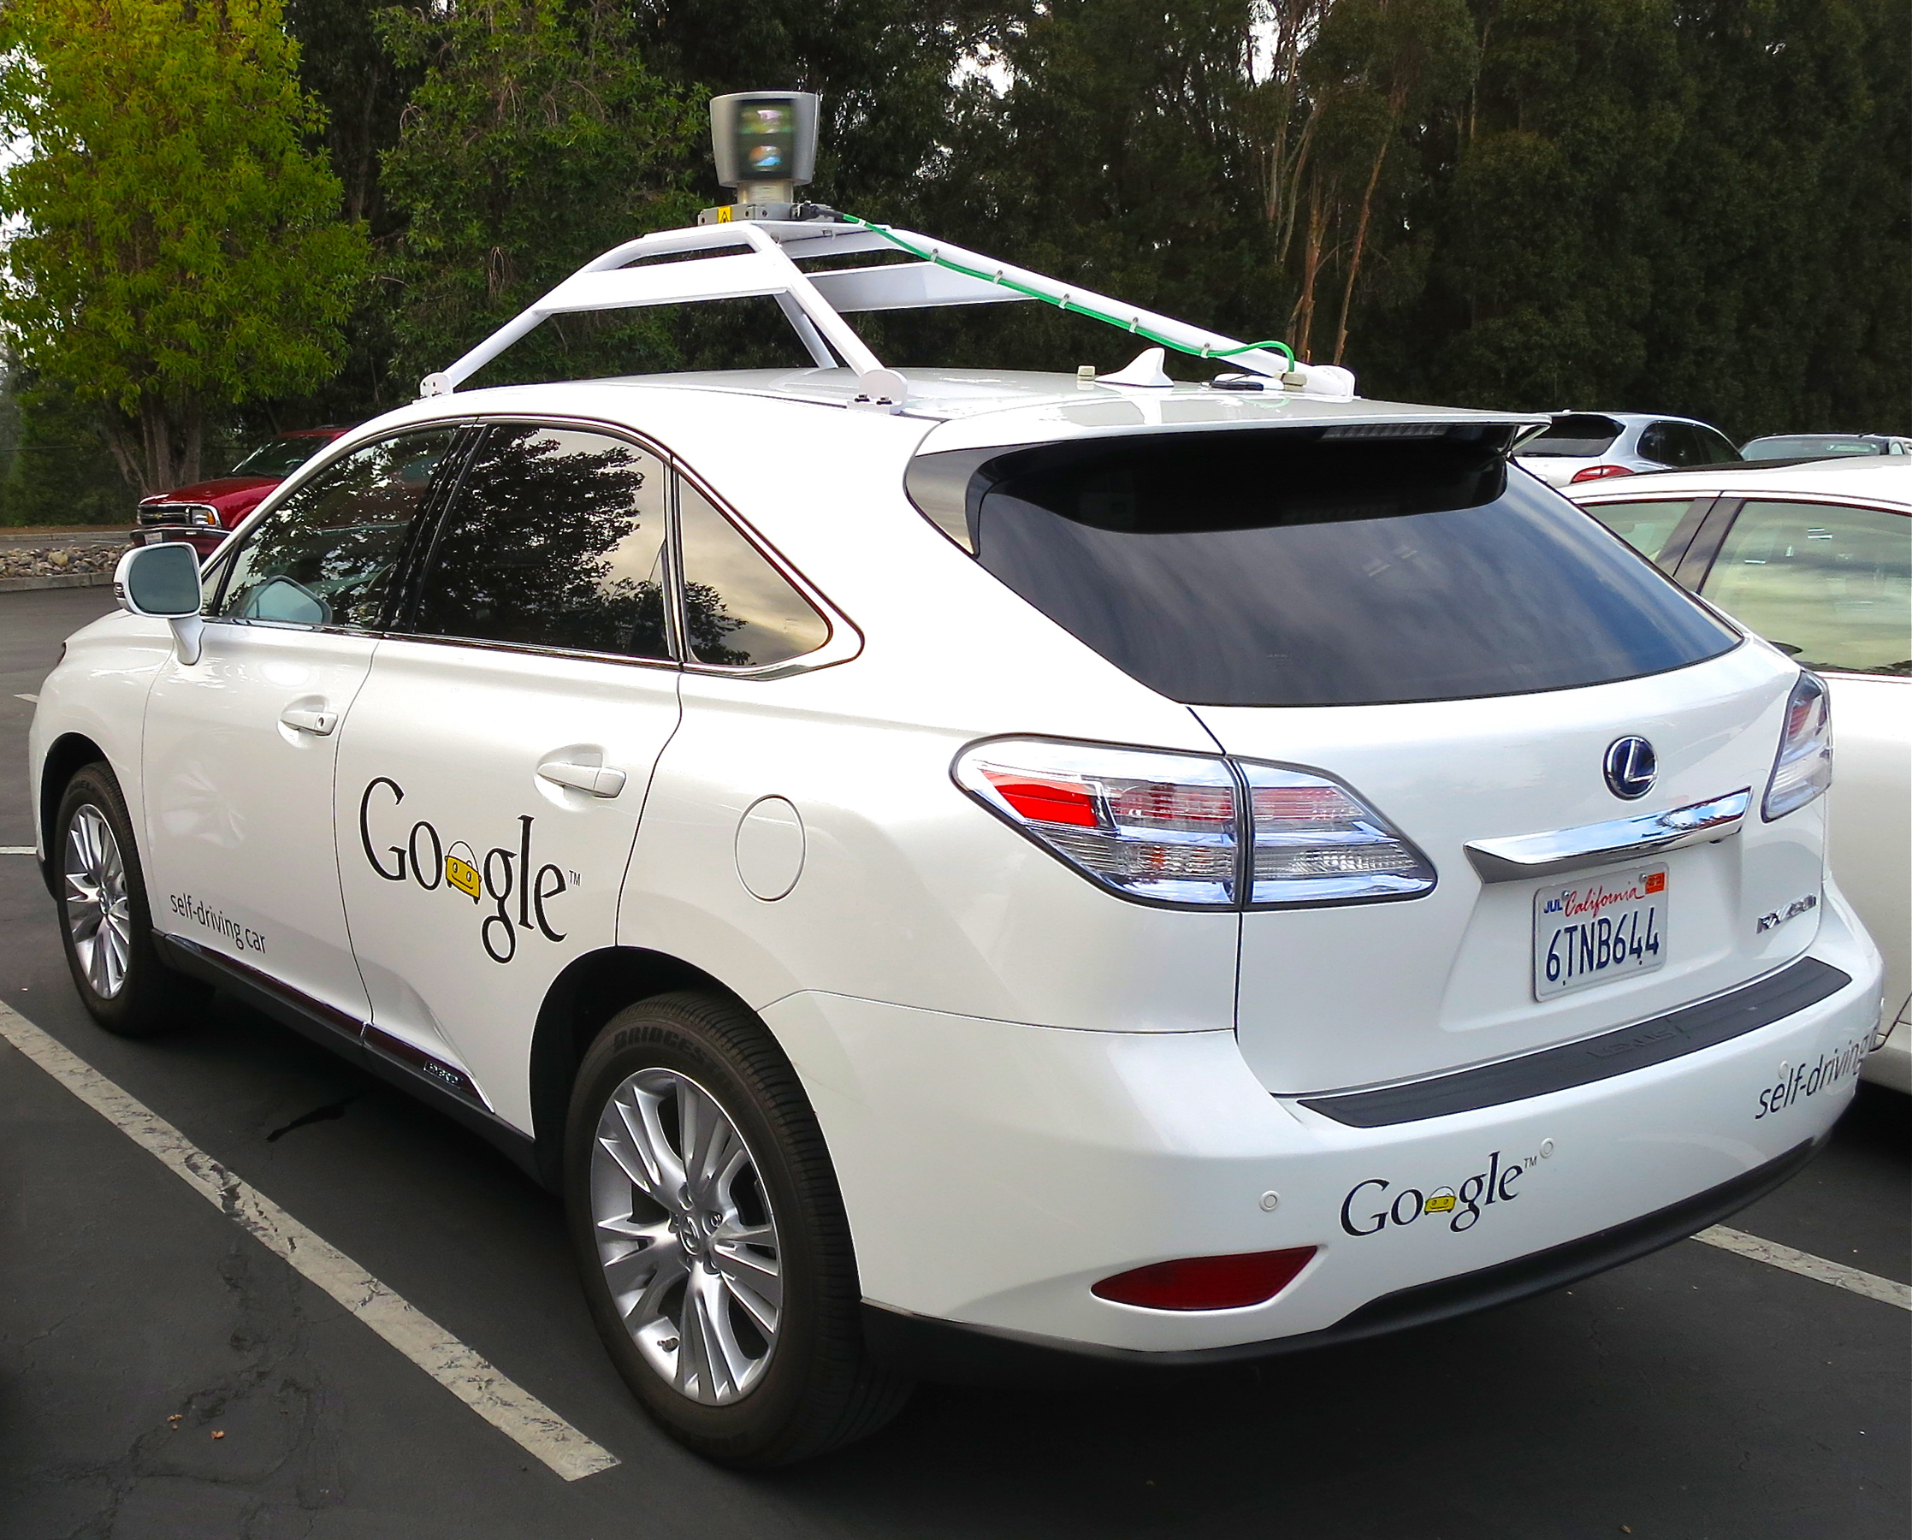
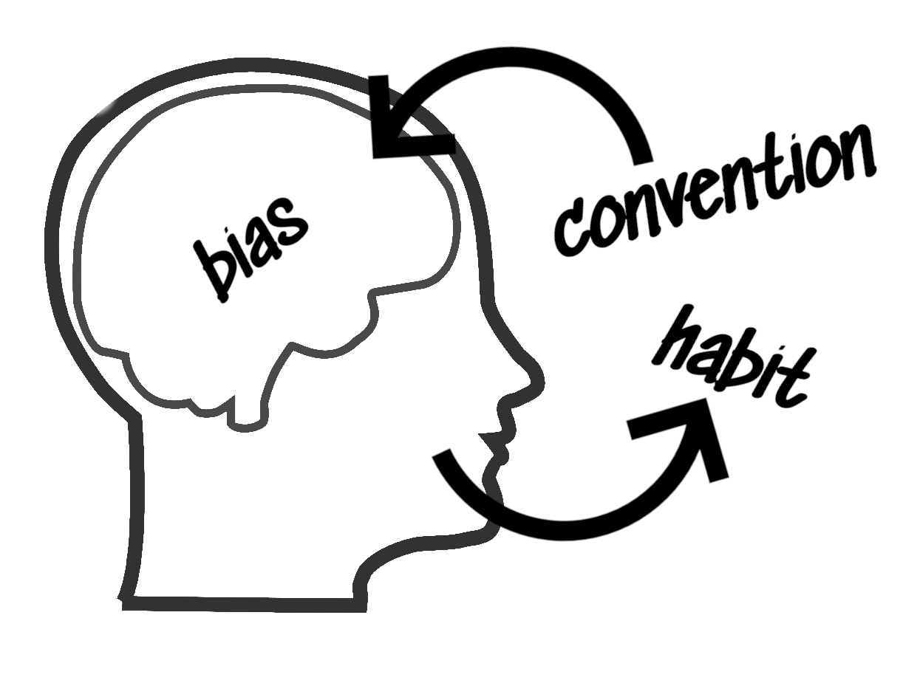
Real World Ethical Dilemmas
Discuss each of the following ethical dilemmas with those around you and decide one what party should be held accountable AND/OR how it could have been prevented.
Consider the 5 Pillars of Trust in Artificial Intelligence and if those were withheld in each scenario.

Slide 12
Dilemma 1: Medical Records Leaked
In 2020, a company called Cense AI, using user data for “automation management solutions”, leaked the data of 2.5 million users by placing the data in an insecure location online before uploading it on to their servers.
The data contained medical information about users including names, insurance information, and medical diagnosis. This data could have easily been illegally sold if recovered.
Who is responsible in this scenario? How could this have been prevented?

Slide 13
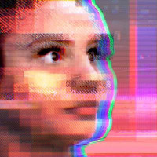
Dilemma 2: Chatbot Bias and Discrimination
In March of 2016, Microsoft released a chatbot on Twitter called “Tay” that learned from the conversations it had with users and their responses.
Users were able to manipulate the chatbot with their responses resulting in extremely offensive responses and comments from the chatbot as it tried to imitate them.
Who is responsible in this scenario? How could this have been prevented?

Slide 14
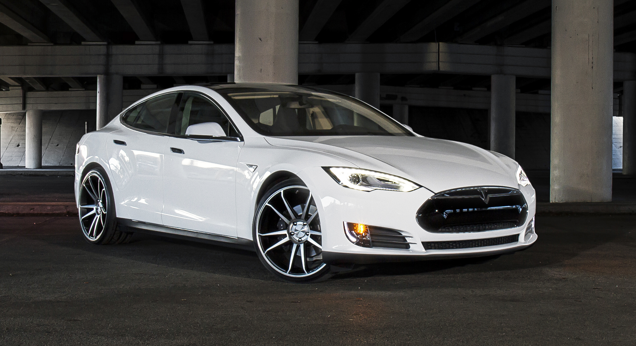

Dilemma 3: Self-Driving Car Accidents
In November of 2022, a Tesla Model S was responsible for a car crash on the San Francisco Bay bridge involving a total of 8 vehicles.
When this accident occurred, the driver reported that the car was “full self driving mode”. Tesla has made known to users that “active driver supervision” is required during this mode as it is not fully autonomous.
Who is responsible in this scenario? How could this have been prevented?

Slide 15
Looking into the Future of Human and AI Interaction
Discuss and answer the following questions with those around you:
Do you think AI will ever be sufficient to completely replace human intelligence? How about art and culture?
Do you think that AI replacing human jobs is ethical? Should AI be a substitute for human effort, or just a tool used to make it more effective?

